Slide 1

RUMYPET(R U my pet?)
Team Groza
(Presenter) Kim Tae Hong (20132335)
Kim Chan Il (20150577)
Paeng Jin Wook (20154645)

Slide 2

Contents
Schedule & Progress
Problems & Solutions
Plans
Q&A

Slide 3
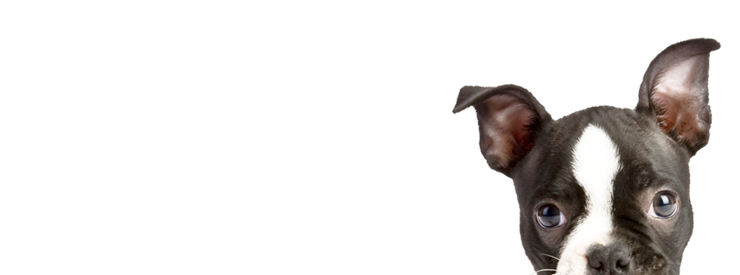
1. SCHEDULE & PROGRESS

Slide 4
SCHEDULE
Week |  | To-Do (can be changed)
Week 9 |  | Hold a meeting and make a Plan based on Midterm Demonstration.
Week 10 |  | Android : Image Upload Function. Server : Add a image data column in database and link with python code. Python : Link to the server
Week 11 |  | Android : E-mail Certification function. Server : link to python code completely and buy a server. Python : Find the way to save the feature template in database.
Week 12 |  | Android : Complete the detail function. (Edit Profile, etc...) Server : Divide the mode of the function in server. Python : Code refactoring and enhance the performance.
Week 13 |  | Android : Release the Beta Version and unit testing by users. Server : move the data to the database that we bought, and refactor. Python : Code refactoring and enhance the performance.
Week 14 |  | Final Demonstration
Week 15 |  | Report Submission
Week 16 |  | Survey & Final Arrangment
4
Notes:
This is the schedule later.

Slide 5
Role of this week
Week 12 |  | Android : Complete the detail function. (Edit Profile, etc...) Server : Divide the mode of the function in server(Complete Verification mode) Python : Code refactoring and enhance the performance.
5

Slide 6

Schedule & Progress – Kim Tae Hong(Android& Server)
“Saved the Image at the Local Server”
Save the Dog Image
Save the dog Nose Image
Save the Input image at Server & Execute the Verification Python Code
6
Notes:
This is the UI Deisign we did last week.
Using this, Chan il Kim applied this into Android Studio.

Slide 7



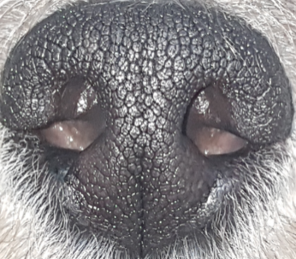

Schedule & Progress – Kim Tae Hong (Server)
“Success Uploading Images to Local Server”
Server Local Directory Structure
7
Notes:
This is the UI Deisign we did last week.
Using this, Chan il Kim applied this into Android Studio.

Slide 8
Schedule & Progress – Kim Chan Il (Android)
“We uploaded dog Image at dog List”
Click!
Click!
8
Notes:
This is the UI Deisign we did last week.
Using this, Chan il Kim applied this into Android Studio.

Slide 9
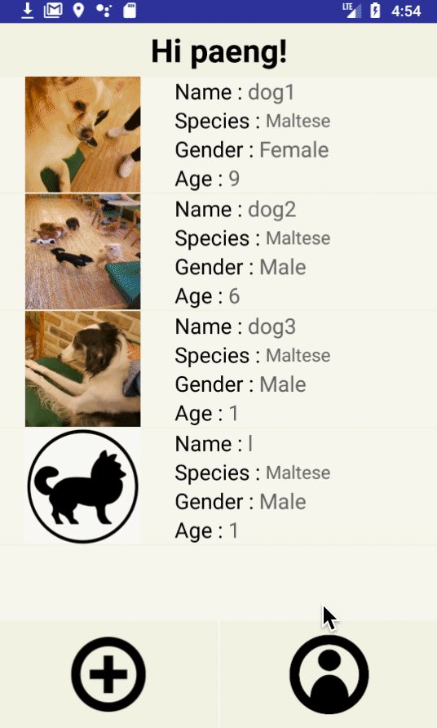
Schedule & Progress – Kim Chan Il (Android)
“Succeeded the Verification in Application”
Click!
9
Notes:
This is the UI Deisign we did last week.
Using this, Chan il Kim applied this into Android Studio.

Slide 10
Schedule & Progress – Kim Chan Il (Server)
“Process of Verification in Application”
Using the PythonShell library
Run the Python Code.
10
Notes:
This is the UI Deisign we did last week.
Using this, Chan il Kim applied this into Android Studio.

Slide 11
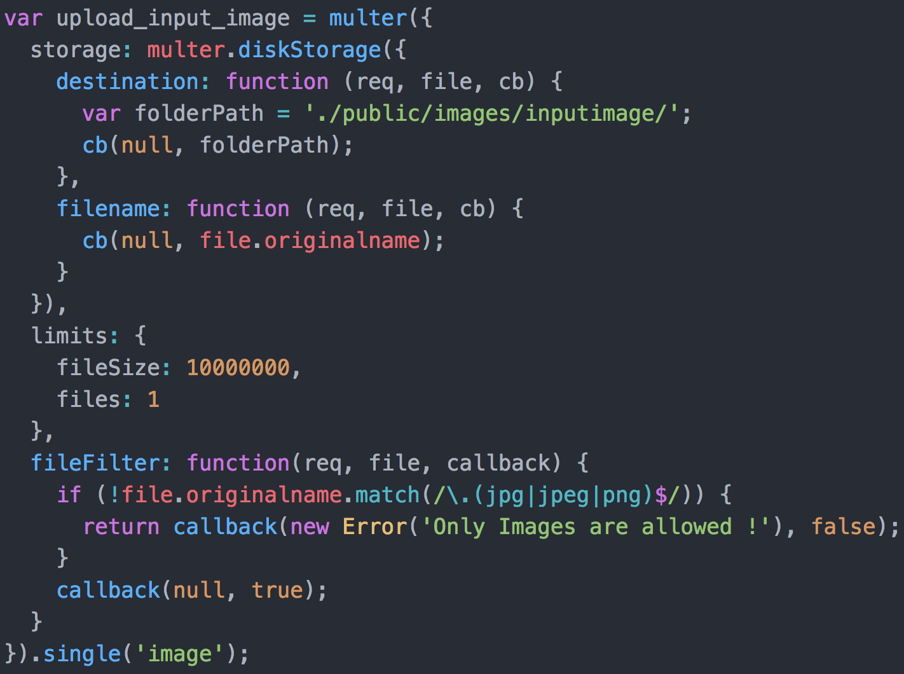
Schedule & Progress – Kim Chan Il (Server)
“Process of Verification in Application”
Compare the Input Image
with its dog nose data
Response the result to Android
11
Notes:
This is the UI Deisign we did last week.
Using this, Chan il Kim applied this into Android Studio.

Slide 12
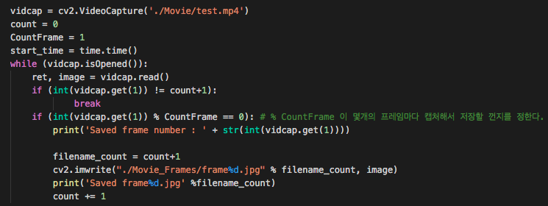
Schedule & Progress – Paeng Jin Wook (Python)
“Captured the Video and Saved the Image”
12

Slide 13
2. PROBLEMS & SOLUTION

Slide 14
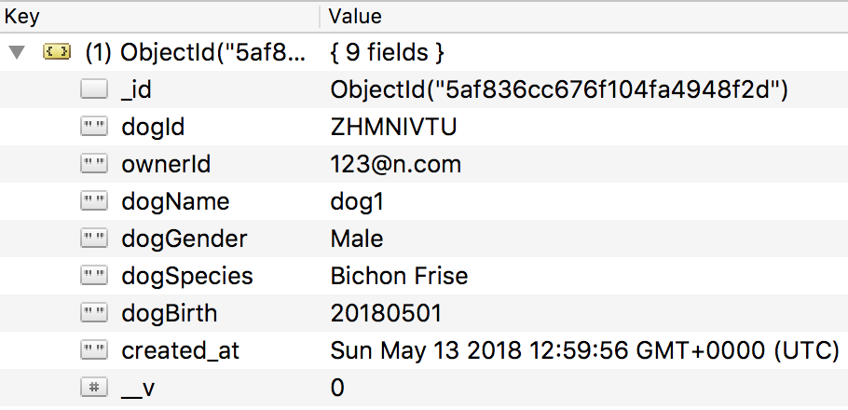


PROBLEMS & SOLUTIONS
Problem 1
When we upload a image in MongoDB as a column, We had some Problem...
Input Image
14
Notes:
--ppt reading--
Now, we have our own server!

Slide 15

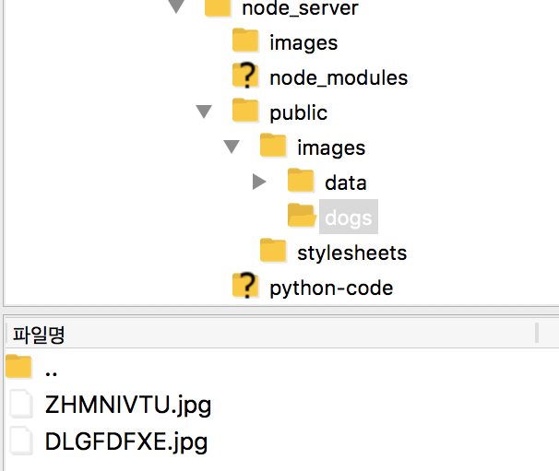
PROBLEMS & SOLUTIONS
Solution 1
We Save it at the local path of the server so that we can later also use it in a python code.
Input Image
15
Notes:
--ppt reading--
Now, we have our own server!

Slide 16

3. PLANS

Slide 17
PLANS for next week
Week 13 | Android : Release the Beta Version and unit testing by users. Server : move the data to the database that we bought, and refactor. Python : Code refactoring and enhance the performance.
17
Notes:
ppt reading

Slide 18
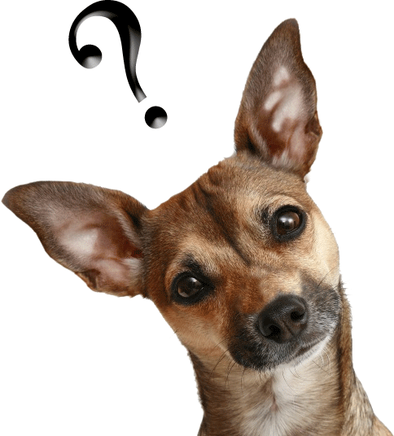
Q&A

Slide 19
Thank you!

